Slide 1
Issues – RCA
Yarn Log Aggregation
Spark code failure
Spark UI Port dynamic allocation
Sqoop import failure for Oracle table
Yarn user not found
UnresolvedAddressException

Slide 2
Spark Concepts

Slide 3
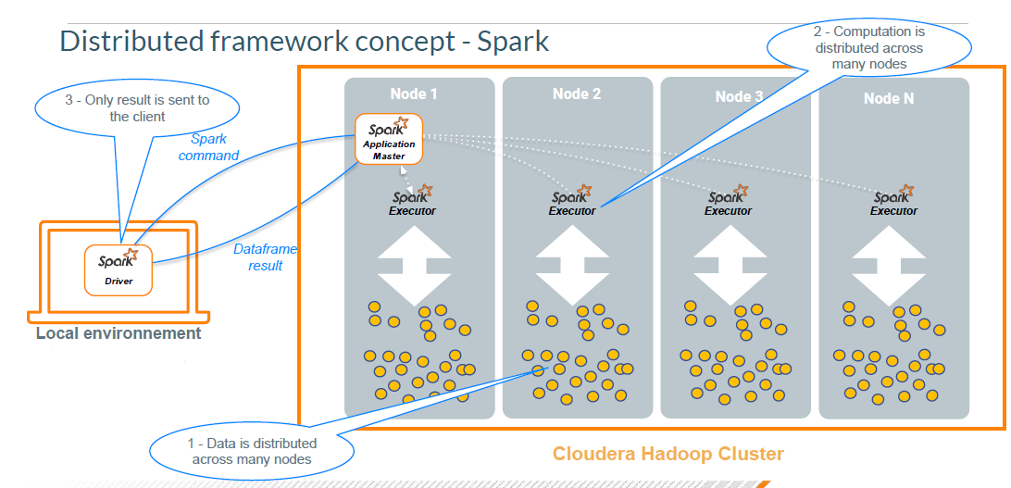

Slide 4
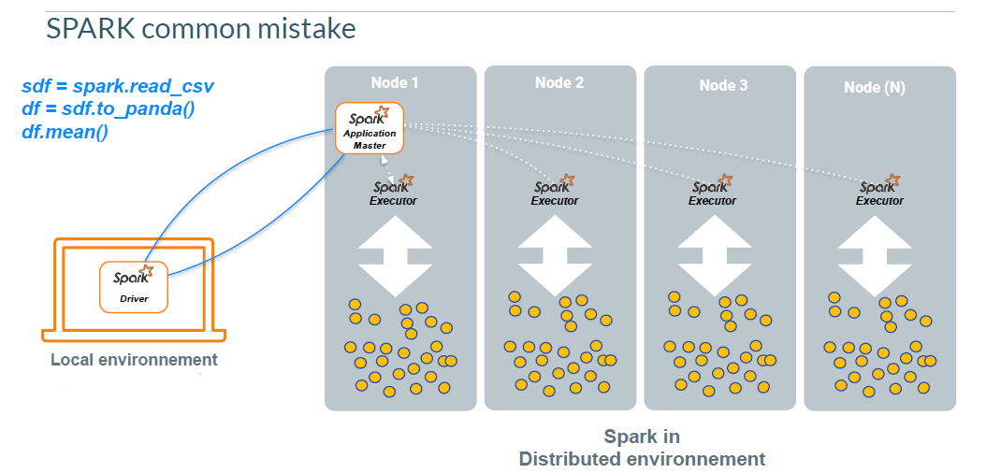

Slide 5
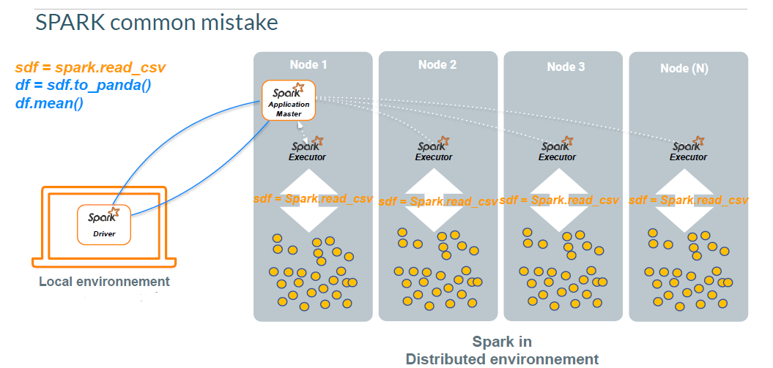

Slide 6
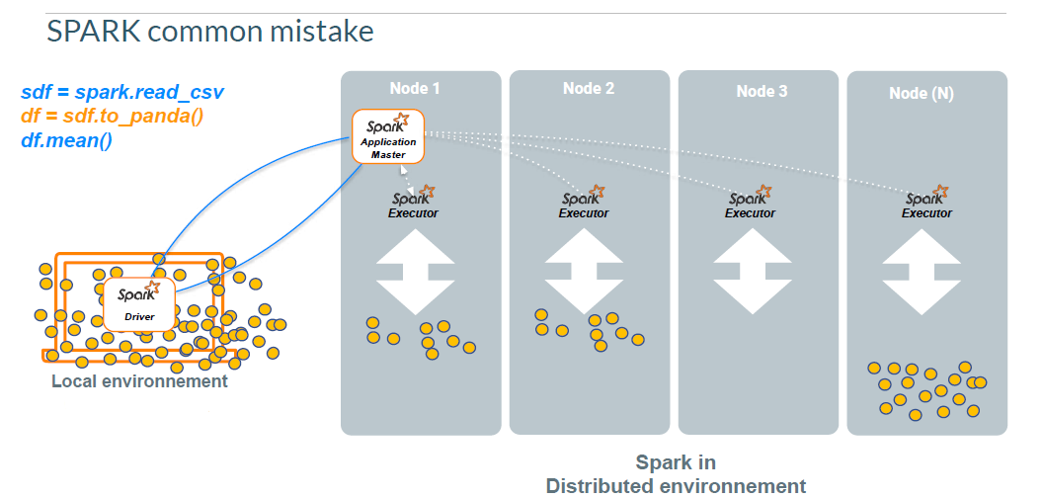

Slide 7
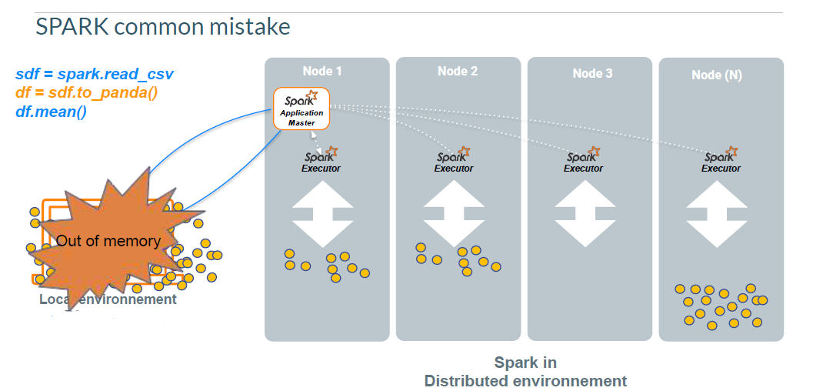

Slide 8
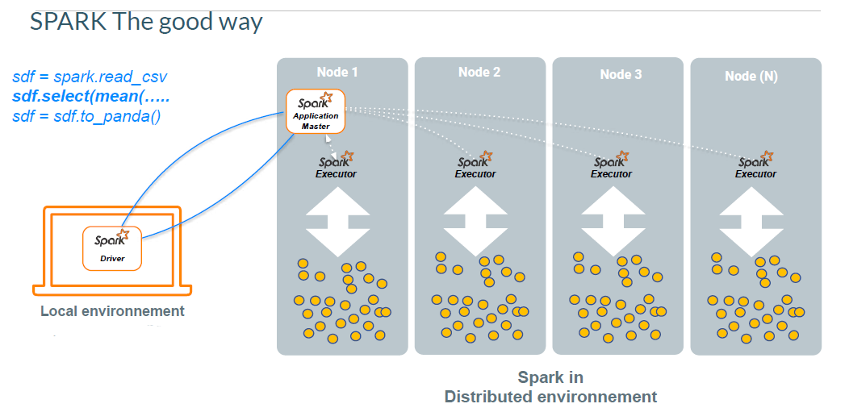

Slide 9
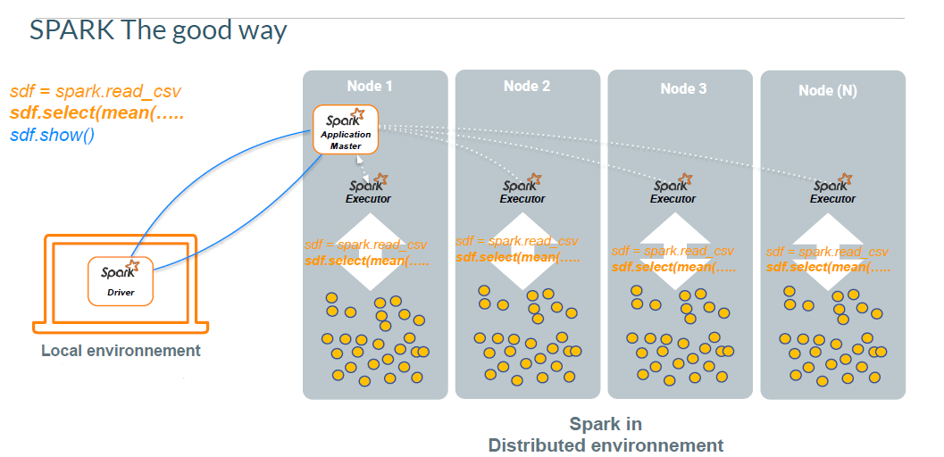

Slide 10
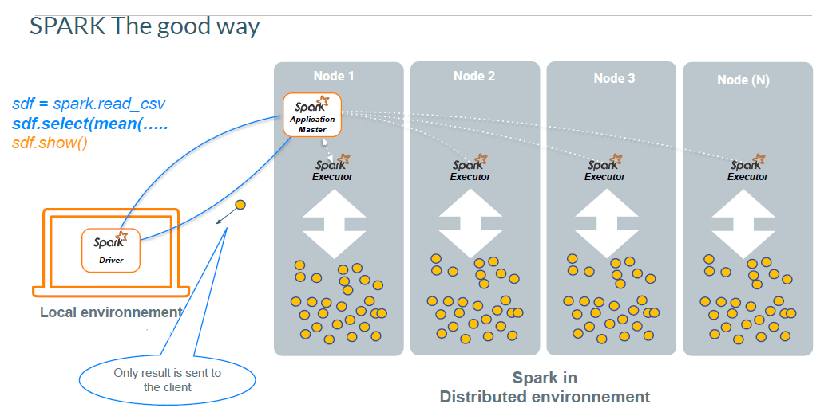

Slide 11
Recommendations
Use native spark functions
Only bring aggregated data back -> perform all computations on the cluster
Be careful with dependencies (especially with pyspark)
Understand and if possible plan the dataflow
Be careful with shuffles (groupBy, sorts, … )
Be careful with joins
Be aware of data skews

Slide 12
Pandas API on Spark

Slide 13


Slide 14
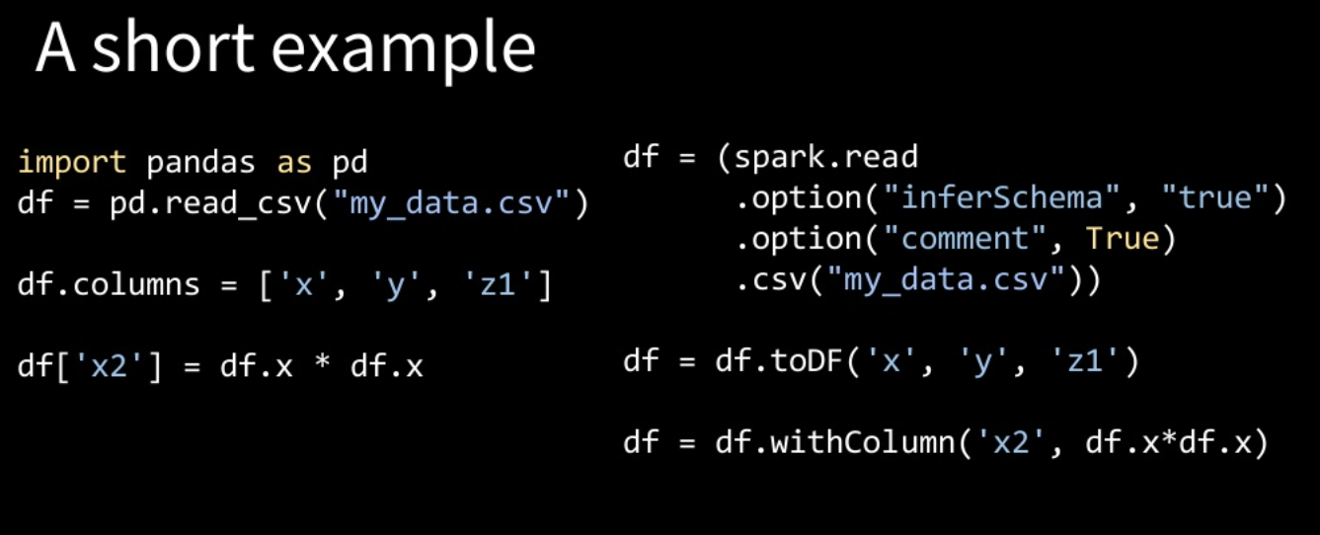

Slide 15
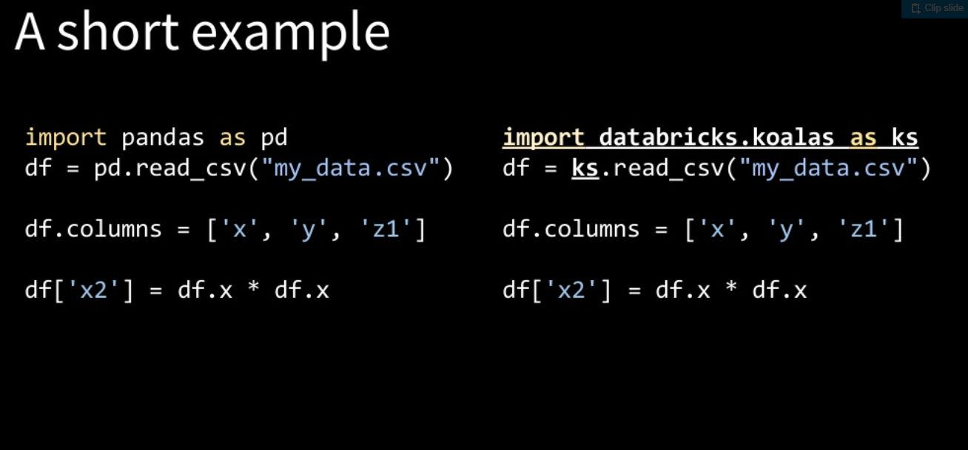

Slide 16
Best Practices
(Partitioning and Bucketing )

Slide 17
Choose no more than two levels of partitioning.
Partition along columns that are likely to be filtered in queries on the data.
Keep partition count in a table at max of 1000 – 2000 for optimal performance.
Never partition on columns that have high cardinality.
Target an optimal range of 256 Mb – 1 Gb of file size inside each partition/bucket.
Ensure partitions do not contains too many small files.
In case of small file issues in cluster, bucketing is better skipped when using Parquet tables.

Slide 18
Thank You

